Slide 1
BioMedical Learning through Graph Neural Networks
Dr. Nisha Pillai
Postdoctoral Associate @ Mississippi State University

Slide 2
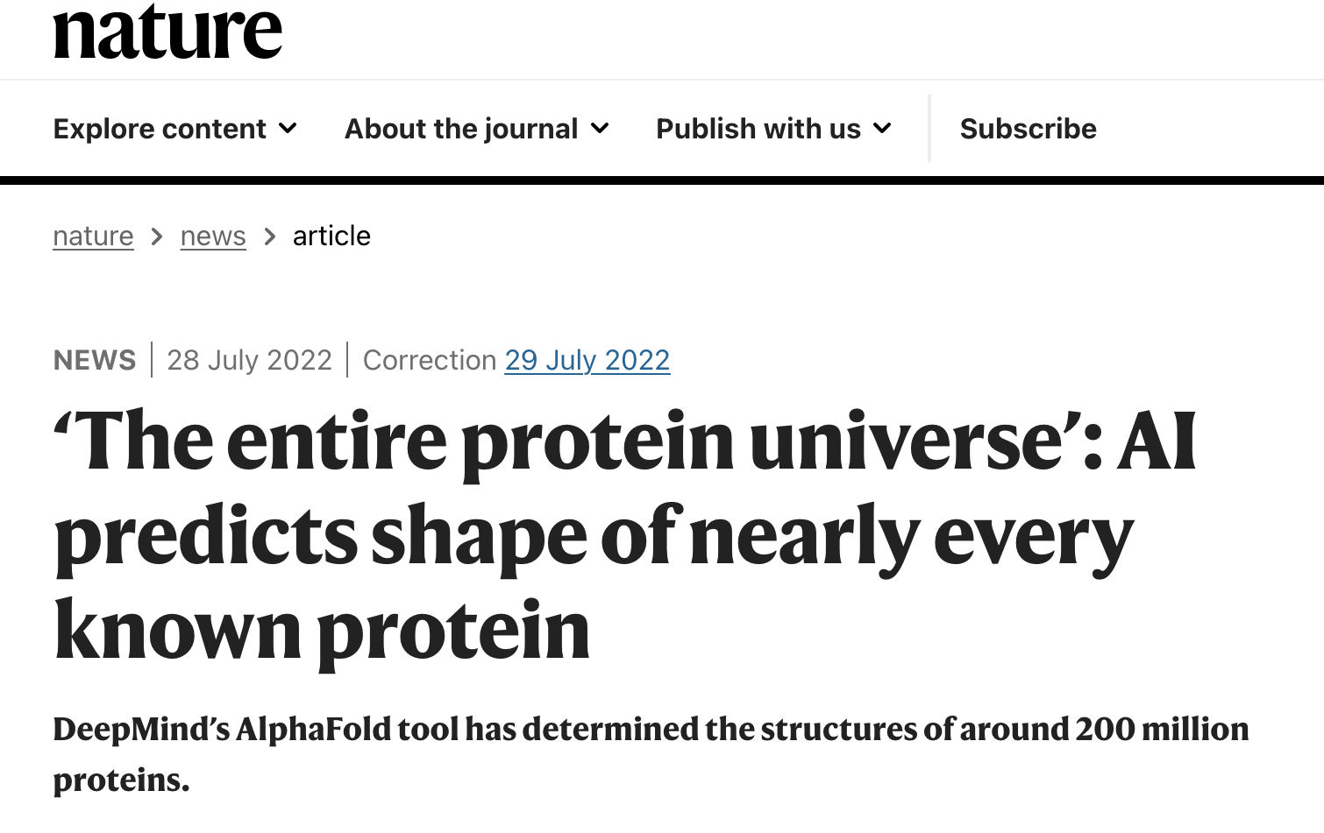
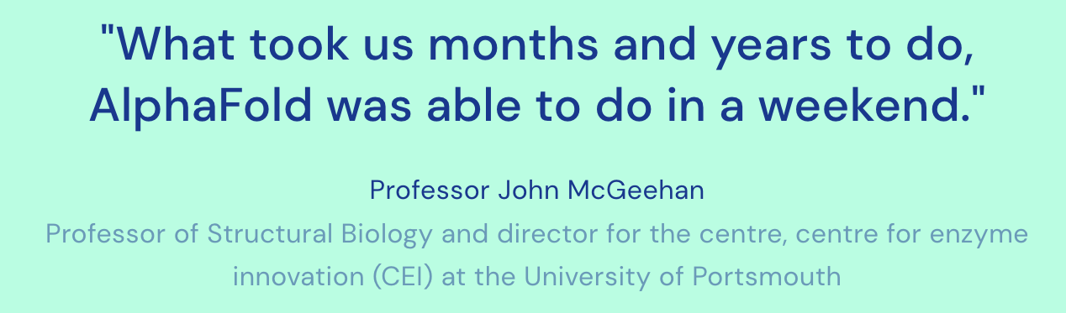
Source: @Nature, Deepmind

Slide 3
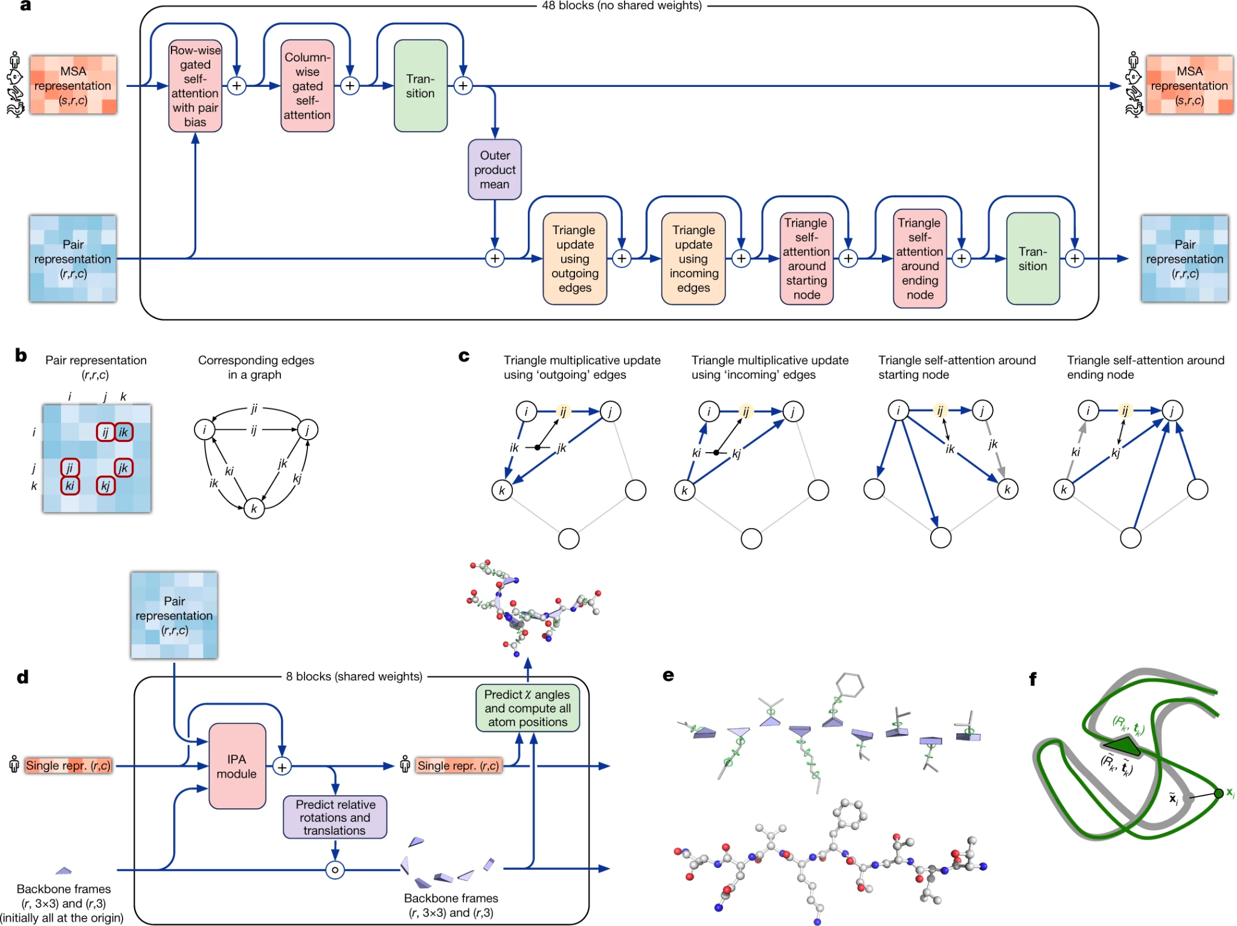
Graphs! Graphs!
Jumper, J., Evans, R., Pritzel, A. et al. Highly accurate protein structure prediction with AlphaFold. Nature 596, 583–589 (2021)

Slide 4
Today’s Focus
Terminology and representations
Popular architectures
An architecture demonstration
Related Work

Slide 5
Graphs
Real world objects, and their connections
G = {V, E}, V → Nodes, E → Edges
Directed / Undirected
Sanchez-Lengeling, et al., "A Gentle Introduction to Graph Neural Networks", Distill, 2021.

Slide 6
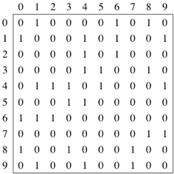
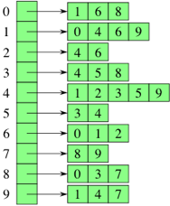
Representing Graphs
a) Edge lists → ((v₁, v₂)....(v₄,v₆))
b) Adjacency Matrices c) Adjacency Lists
[ [0 1 0 0 0..] [[1,6,8]
..... …..
[0 1 0 0..]] [1,4,7]]
Source: Khan Academy

Slide 7
Properties
Degree of a node → Number of neighbours
Distance between Node A and B → shortest path
Eccentricity → Maximum distance between A to anynode
Connected components → Linked nodes
Center of connected component

Slide 8
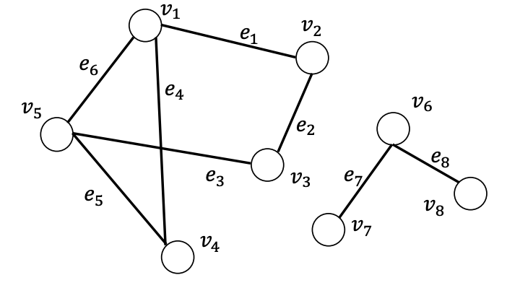
Connected Graphs
Trail → Walk with distinct edges
Path → Walk with distinct nodes
Source: Deep Learning on Graphs, Yao Ma and Jiliang Tang

Slide 9
Node Centrality
Importance of a node
Degree based → Number of neighbour nodes
Eigenvector centrality
Catz centrality
Betweenness centrality
Source: Deep Learning on Graphs, Yao Ma and Jiliang Tang

Slide 10
Node Centrality
Eigenvector centrality
largest eigenvalue of adjacency matrix
eigen vector as centrality score vector
Betweenness centrality
Number of shortest paths passing through a node
Source: Deep Learning on Graphs, Yao Ma and Jiliang Tang

Slide 11
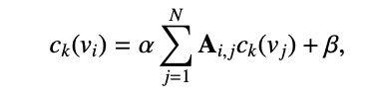
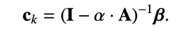
Katz Centrality
Variant of eigenvector centrality
Source: Deep Learning on Graphs, Yao Ma and Jiliang Tang

Slide 12
Applications in Biology
Protein-Protein Interaction (PPI)
Interactions among proteins, Proteins as nodes, interactions as edges
Gene regulatory networks
Regulating gene expression, generating proteins from DNA sequence
Metabolic networks
Metabolic reactions in a living organisms, enzymes as edges
Drug drug interaction networks
Giulia Muzio et al. Biological network analysis with deep learning, Bioinformatics, 2021

Slide 13
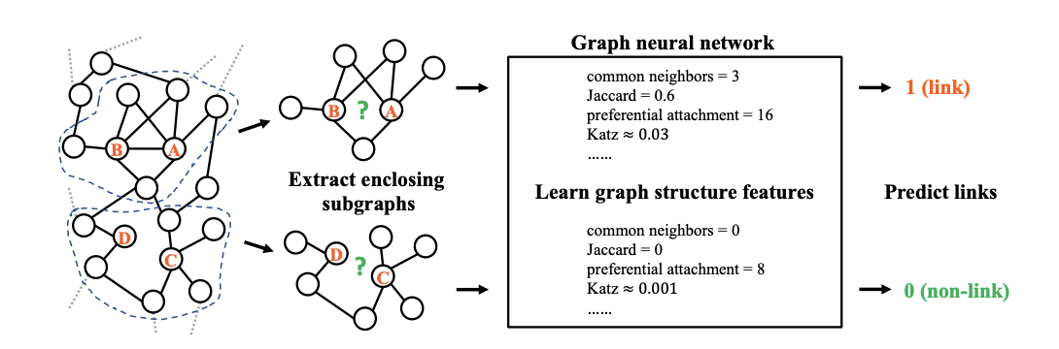
Link Prediction
Zhang and Chen, Link Prediction Based on Graph Neural Networks, NeurIPS 2018

Slide 14
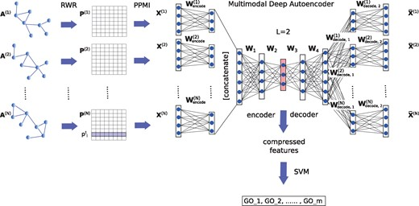
Node Classification
Gligorijević V, Barot M, Bonneau R. deepNF: deep network fusion for protein function prediction. Bioinformatics, 2018.

Slide 15
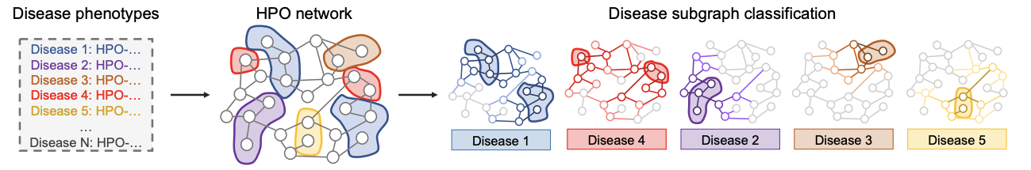
Graph Classification
Michelle M. Li, Kexin Huang, Marinka Zitnik, Graph Representation Learning in Biomedicine, 2021

Slide 16
Popular Datasets
Drugbank Protein Interaction Network Analysis
MUTAG Molecular INTeraction
PubChem’s BioAssay database DREAM4
Protein Data Bank Tox21
Human Protein Reference Database
Giulia Muzio et al. Biological network analysis with deep learning, Bioinformatics, 2021

Slide 17
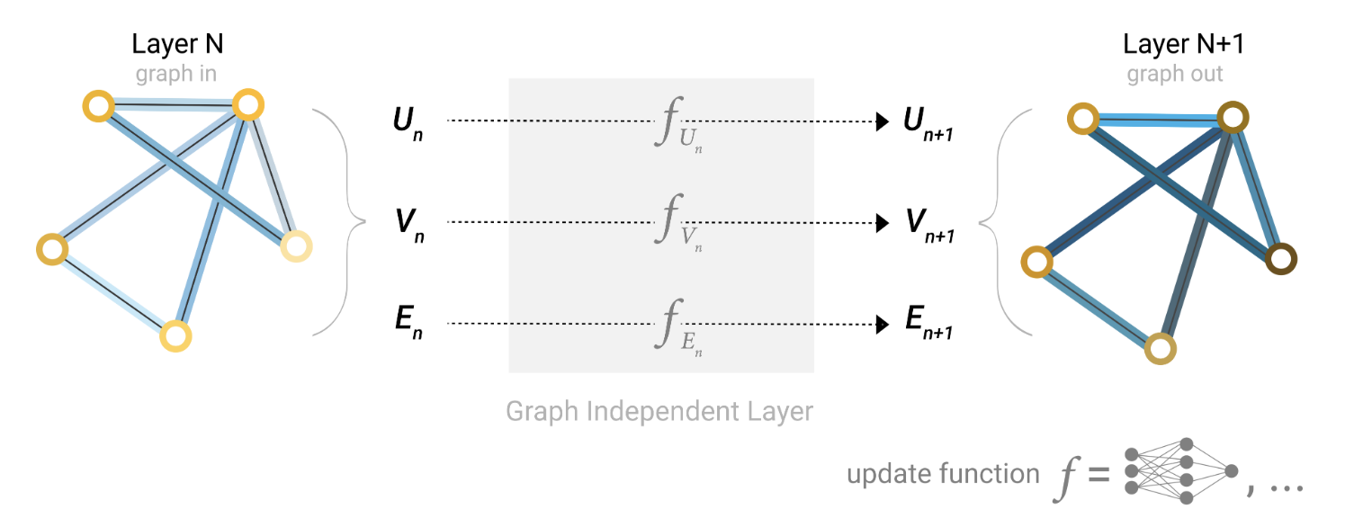
Graph Neural Network Model
Sanchez-Lengeling, et al., "A Gentle Introduction to Graph Neural Networks", Distill, 2021.

Slide 18
Graph Predictions
Pooling → Gather all information in matrix, Average/Sum
Node prediction with no node features → Pooling with edges
Edge prediction with no properties → Pooling with nodes
Global Average Pooling → Graph embedding
Sanchez-Lengeling, et al., "A Gentle Introduction to Graph Neural Networks", Distill, 2021.

Slide 19
Message Passing
Gather neighbour node information
Aggregate them
Update function → an NN method
Sanchez-Lengeling, et al., "A Gentle Introduction to Graph Neural Networks", Distill, 2021.

Slide 20
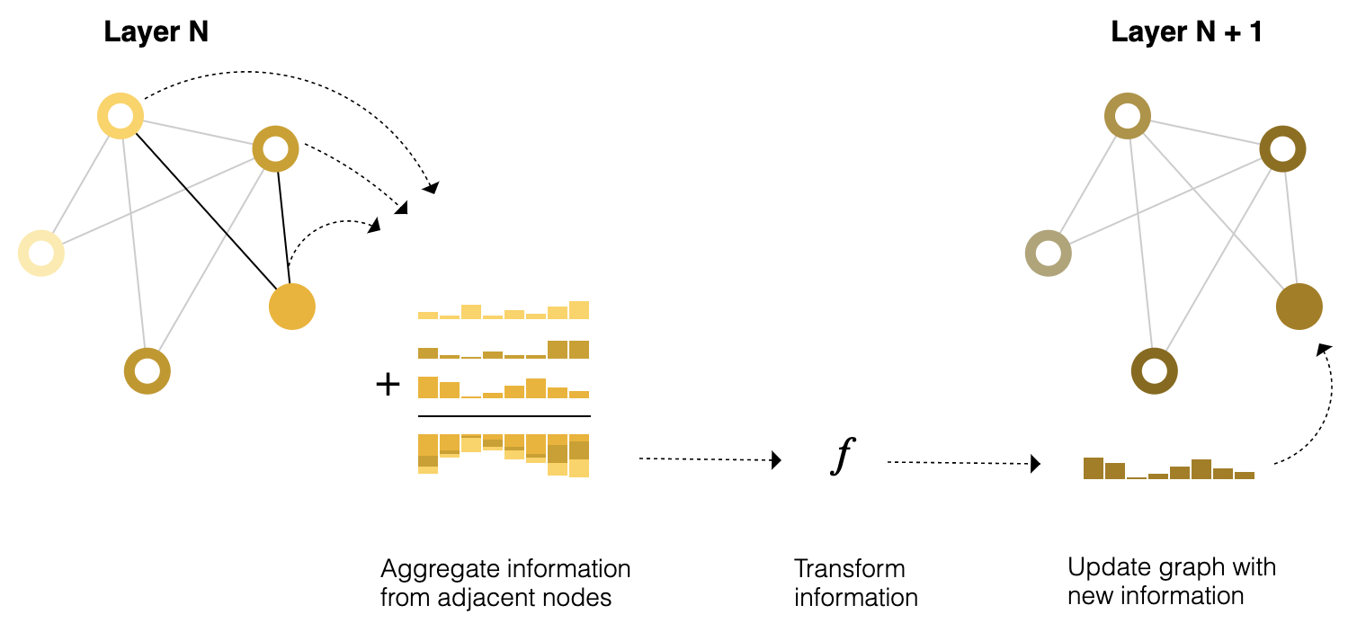
Message Passing
Sanchez-Lengeling, et al., "A Gentle Introduction to Graph Neural Networks", Distill, 2021.

Slide 21
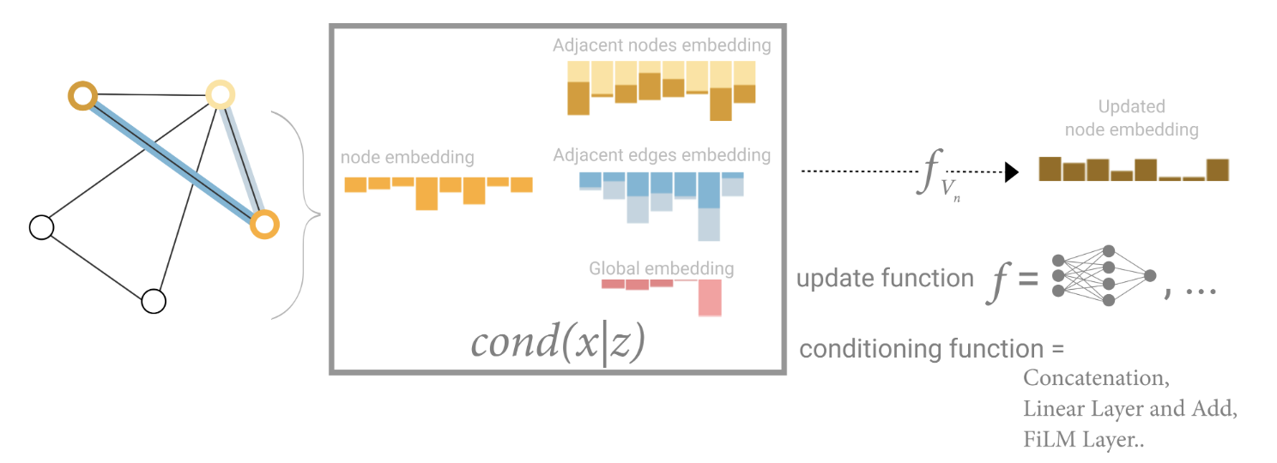
Global Representation
Sanchez-Lengeling, et al., "A Gentle Introduction to Graph Neural Networks", Distill, 2021.

Slide 22
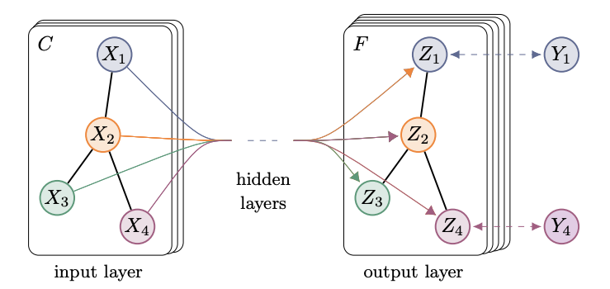
Graph Convolutional Networks
Thomas N. Kipf, Max Welling, "Semi-Supervised Classification with Graph Convolutional Networks, 2016.

Slide 23
Graph Convolutional Networks
Inputs: Initial feature vector for nodes, adjacency list
H^{l+1} = f(H^{l} , A), L - number of layers
Let the “f” be ReLU,
H^{l+1} = ReLU(AH^{l}W^{l}), W is the weight matrix,
ReLU is a non-linear activation function, To normalize, 1/D_{i}^{1/2} A 1/D_{j}^{1/}

Slide 24
Implementations
Pytorch: https://pytorch-geometric.readthedocs.io/en/1.3.2/_modules/torch_geometric/nn/conv/gcn_conv.html
Tensorflow: https://github.com/stellargraph/stellargraph/blob/develop/stellargraph/layer/gcn.py

Slide 25
Deep Walk
Adjacent nodes ←→ Similar representations
Transductive algorithm
Random walks of “L” length, “k” times
SkipGram method
Gradient descent to update neighbour node

Slide 26
GraphSage
Dynamic graph learning - No need to retrain
Context based similarity representations
Random Walks
Learning weights using aggregate function
Neural network layer to learn weights

Slide 27
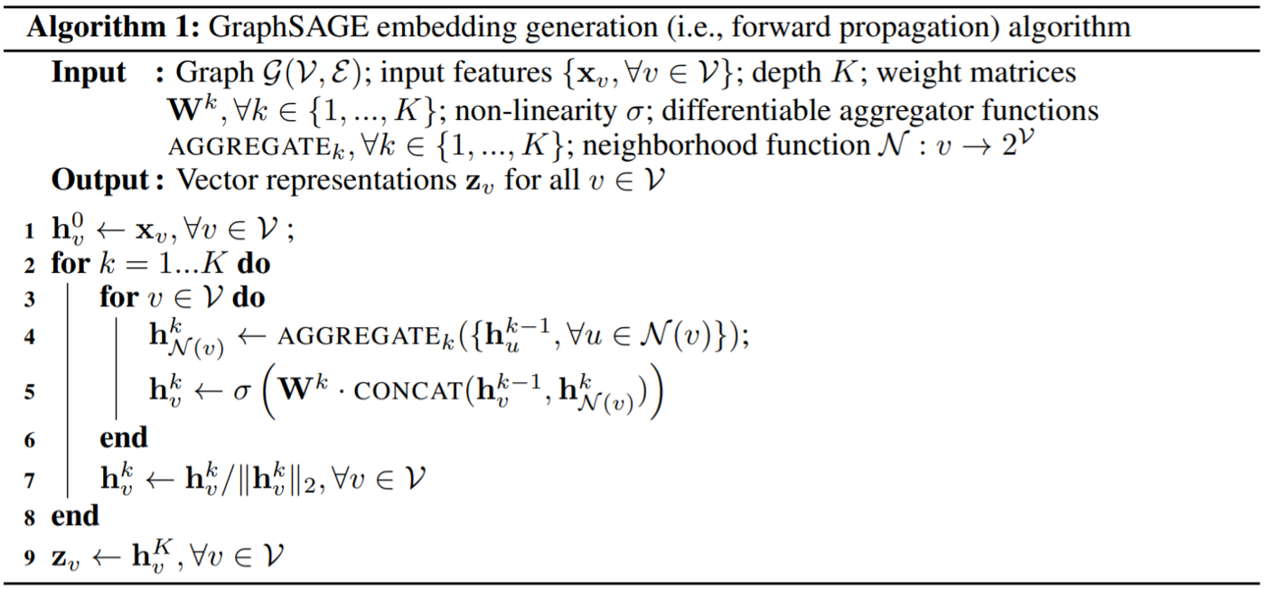
GraphSage
Hamilton, Will, Zhitao Ying, and Jure Leskovec. “Inductive representation learning on large graphs.” , NeuIPS, 2017.
.

Slide 28
Graph Attention Networks
Attention mechanism → higher weight for important nodes
Linear transformation, W^{l}H^{l}
Additive attention
Concatenate 2 neighbour features
Multiply with weight vector, a.
Apply LeakyReLU
Normalize with softmax
GCN

Slide 29
Graph Encoder
To find a representative embedding
Encoder layer → Graph convolutional layers, non-linear activations
Decoder layer - Graph convolutional layers
Reconstruction loss to find the difference.

Slide 30
Demonstration

Slide 31
Brain Decoding
Multidomain brain decoder for brain response
Graph classification
Human Connectome Project task-fMRI database
1200 participants, 21 different experimental conditions
6 cognitive domain: emotion, language, motor, relational, social, and working memory.
Yu Zhang, Loïc Tetrel, Bertrand Thirion, Pierre Bellec
“Functional annotation of human cognitive states using deep graph convolution” , 2021
.

Slide 32
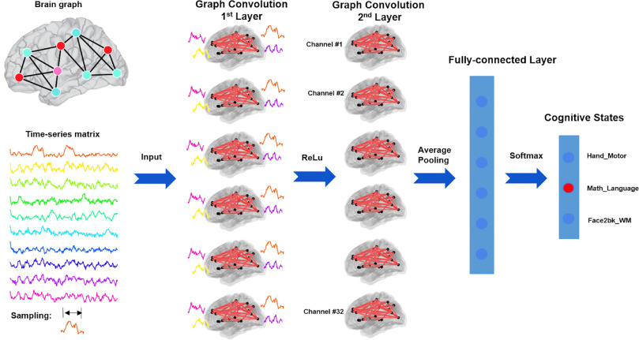
Brain Decoding
6 GCN layers with 32 graph filters
Global average pooling layer,
2 fully connected layers
Softmax layer
Yu Zhang, Loïc Tetrel, Bertrand Thirion, Pierre Bellec
“Functional annotation of human cognitive states using deep graph convolution” , 2021
.

Slide 33
Autism Spectrum Disorder
Graph node classification
Autism Brain Imaging Data Exchange (ABIDE) dataset
Gender and site information → Population Graph
Imaging features → Node feature vector
Anirudh, R., and Thiagarajan, J
Bootstrapping graph convolutional neural networks for autism spectrum disorder classification, 2019
.

Slide 34
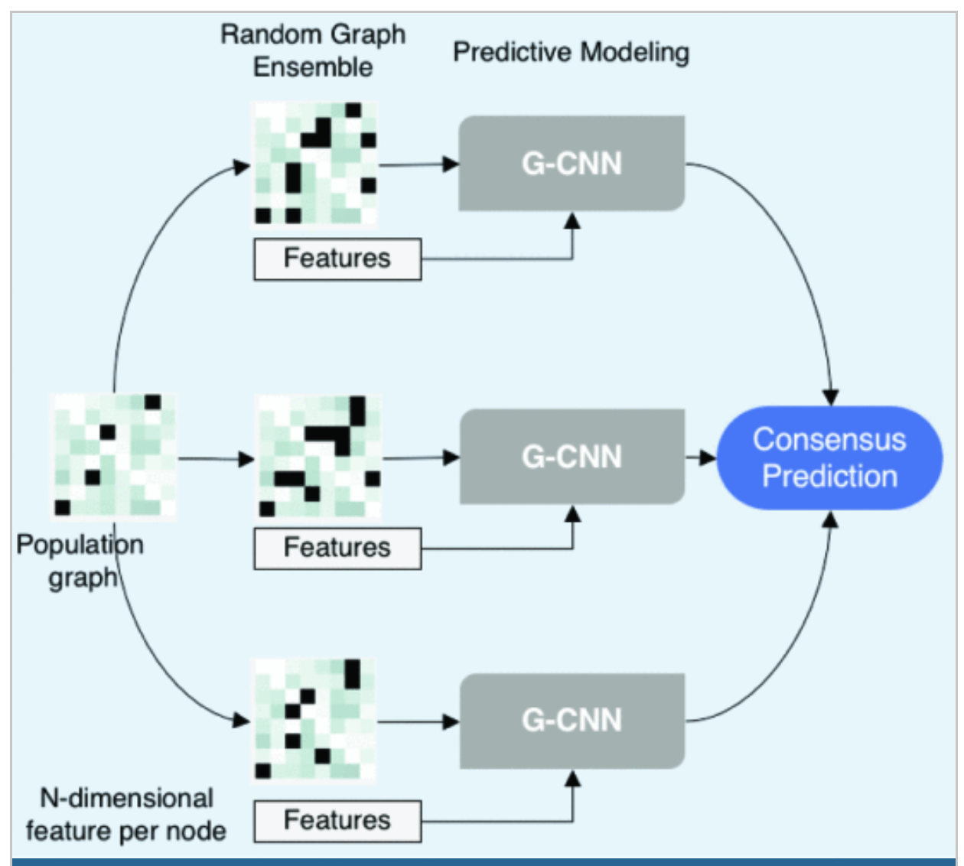
Autism Spectrum Disorder
Anirudh, R., and Thiagarajan, J
Bootstrapping graph convolutional neural networks for autism spectrum disorder classification, 2019
.

Slide 35
Conclusion
Introduction to graph notations
Basic architectures
Some application

